Slide 1
IMPLICATIONS OF FIELD LOADING PATTERNS ON
DIFFERENT TIE SUPPORT CONDITIONS USING
DISCRETE ELEMENT MODELING – DYNAMIC RESPONSES
Transportation Research Board
98th Annual Meeting, January 14, 2019
Bin Feng¹ – Graduate Research Assistant
Wenting Hou¹ – Graduate Research Assistant
Erol Tutumluer¹ – Professor, Paul F. Kent Endowed Faculty Scholar
¹University of Illinois at Urbana-Champaign
Notes:
Animation from the second item, have page number on every slides

Slide 2
OUTLINE
Background
Objective and Approach
Model Calibration
Results and Discussion
Conclusions
Field Loading Patterns

Slide 3
Background

Slide 4
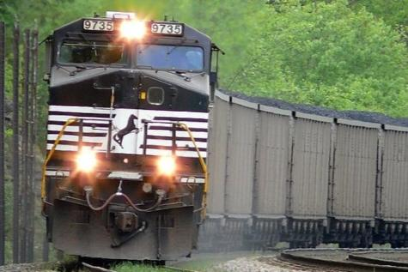
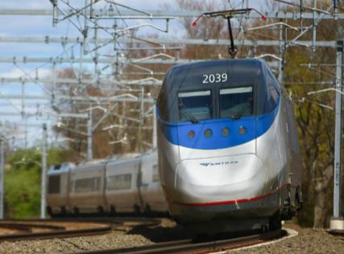
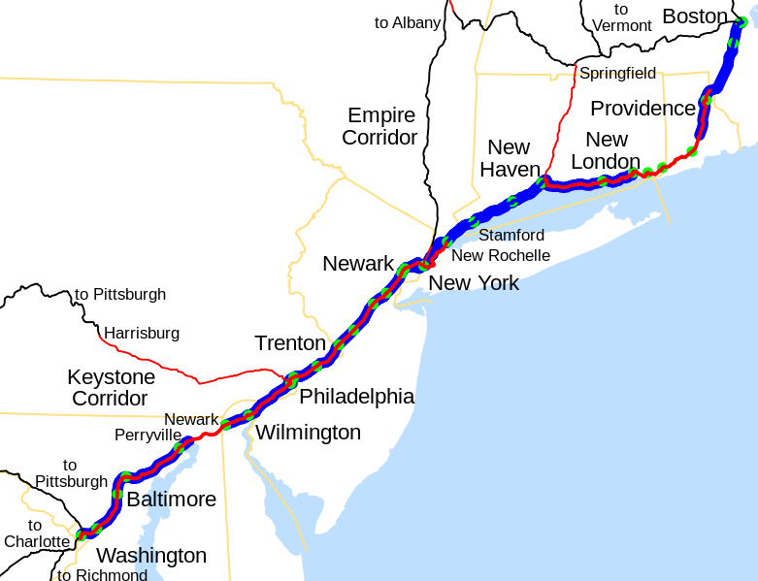
BACKGROUND
US High Speed Rail Depends on Shared Corridor / Shared Track Usage
AMTRAK Northeast Corridor (NEC)
Amtrak passenger train speeds up to 150 mph
Heavy Axle Load freight: 36–39 tons
Can we accommodate the requirements of both, while maintaining high efficiency and performance of each?
4
Notes:
400+ miles northeast
WILD(wheel impact load detector) data, impact force much higher than static force.

Slide 5
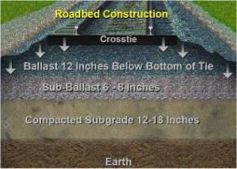
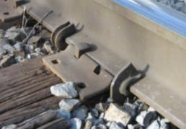
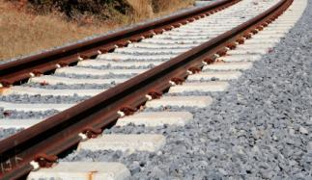
BACKGROUND
Track Structure
Track system and components should be optimized for shared traffic
Corresponding heterogeneous load characteristics
Superstructure
Rails
Fastening systems
Ties (timber vs. concrete)
Tie plates and pads
Substructure
Ballast
Subballast
Subgrade
Forces acting on rail:

Slide 6
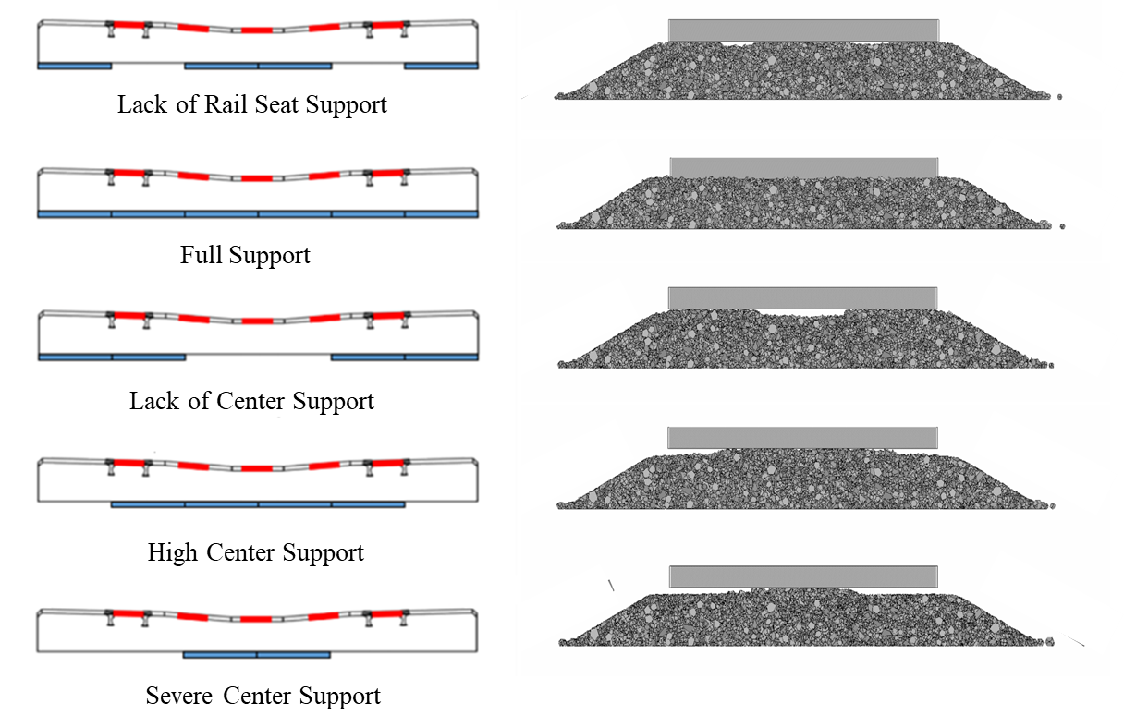
BACKGROUND - Ballast
In shared corridors, under repeated train loading, track geometry deterioration is more likely to be encountered over short performance periods
Ballast layer may quickly undergo non-uniform settlement leading to excessive vibrations of the track system
Previous phase of this research (Hou et al., 2018) shows under severe lack of support condition (i.e., severe center binding), the maximum crosstie-ballast contact force will exceed the AREMA allowable value by over 30% (seat load 20 kips)
Developing non-uniform support condition
Hou, W., Feng, B., Li, W., Tutumluer, E. “Evaluation of Ballast Behavior under Different Tie Support Conditions using Discrete Element Modeling, Transportation Research Record , 2018.
Notes:
animation: figure comes when third paragraph come
static force but now dynamic force

Slide 7
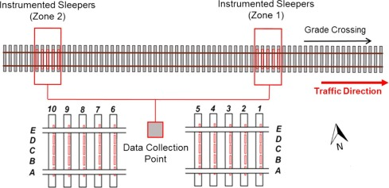
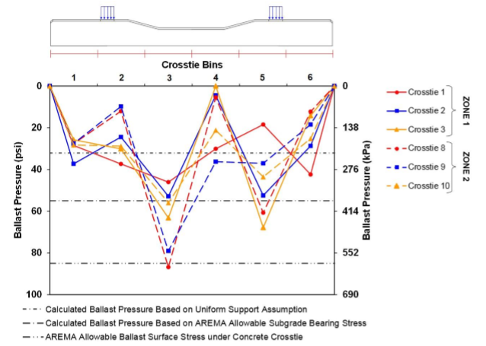


FIELD STUDIES
Amtrak NEC NB
MP 75.12, Edgewood, MD
Track speed 125 mph
Amtrak Concrete Tie and Track Structure Improvement Study at UIUC
Reference: Gao et al. (2017)

Slide 8
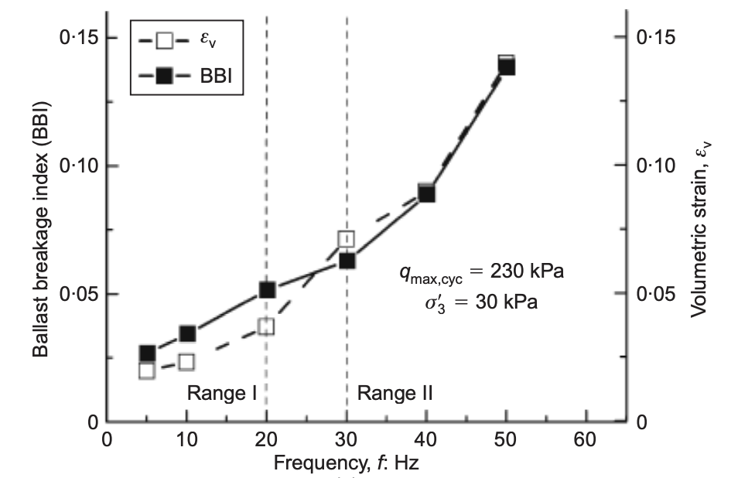
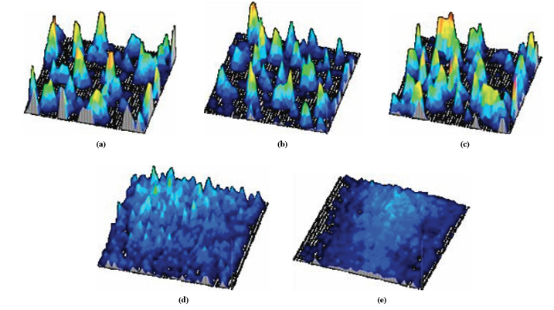
CURRENT STUDIES
Influence of ballast conditions on performance of tie-ballast interface
Reference: McHenry et al. (2015)
Influence of loading frequency on particle breakage
Influence of ballast support conditions and loading patterns on ballast particles and ties?
Reference: Sun et al. (2014)

Slide 9
Objective and Approach

Slide 10
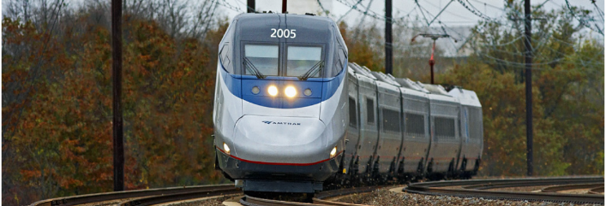
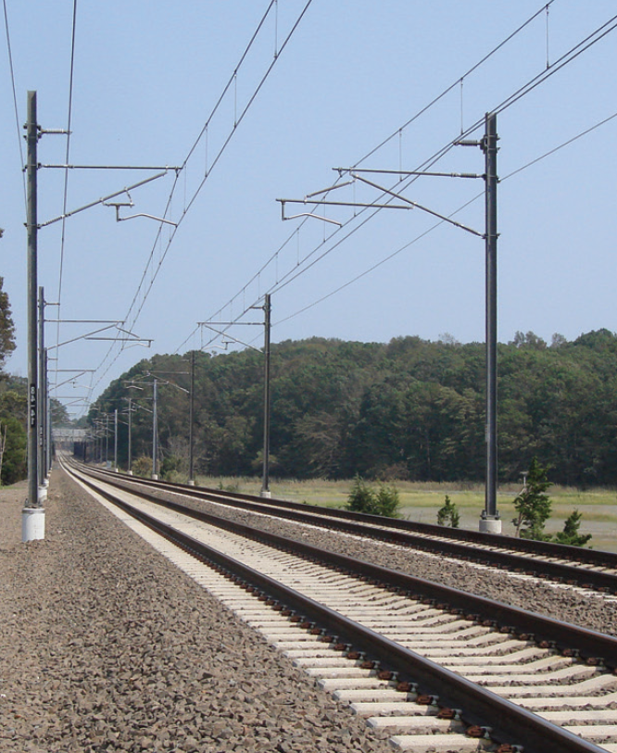
OBJECTIVE
Evaluate the influence of support conditions and loading patterns
Tie-ballast interaction
Tie performance
Ballast particle performance
Amtrak Concrete Tie and Track Structure Improvement Study at UIUC

Slide 11
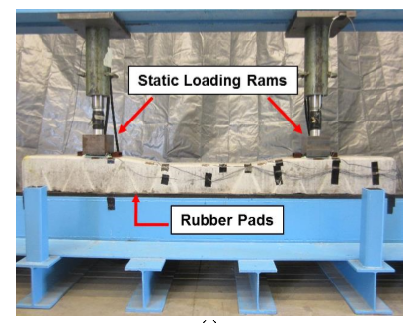
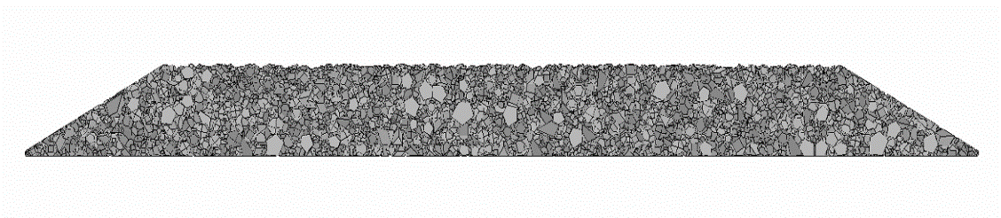
RESEARCH APPROACH
Discrete Element Method (DEM)
proven effective to study granular materials such as ballast
calibrated with previous laboratory testing results
Numerical Modeling (BLOKS3D)
Reference: Hou et al. (2018)
Reference: Gao et al. (2017)
Notes:
more about the lab work (rubber pads), explain

Slide 12
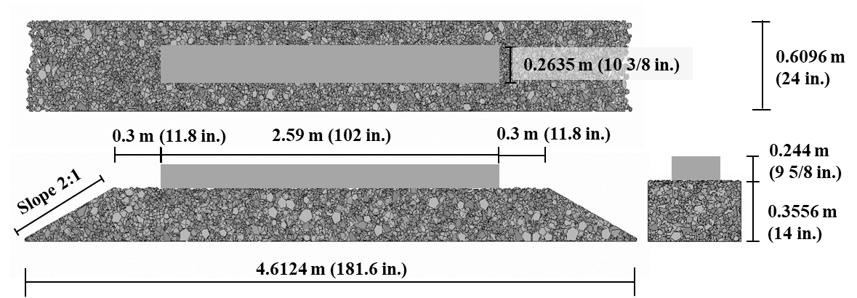
RESEARCH APPROACH
Discrete Element Method (DEM)
Concrete tie dimensions: 10 3/8 × 9 5/8 × 102 in.
Ballast layer dimensions: 14 in. thick × 24 in. wide
Total of ~11,000 ballast particles
Reference: Hou et al. (2018)

Slide 13
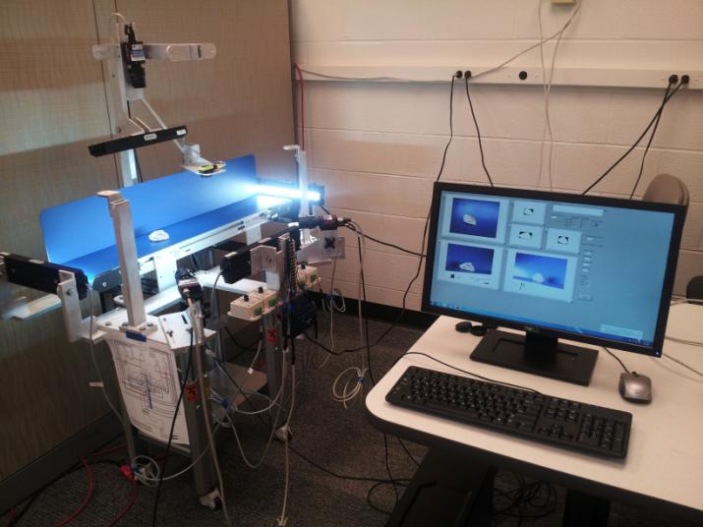
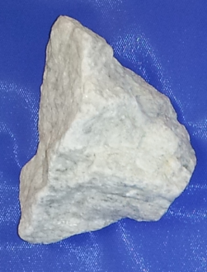


BALLAST PROPERTIES AND DEM MODEL PARAMETERS
Ballast Gradation / Sieve Size |  | Percent Passing (%)
2 ½’’ | 63.5 mm | 100
2’’ | 50.8 mm | 95
1 ½’’ | 38.1 mm | 65
1’’ | 25.4 mm | 10
½’’ | 12.7 mm | 0
Grain size distribution – meets AREMA No. 3 and No. 4A
Particle shape – Enhanced UI Aggregate Image analyzer
Parameters in DEM:
Normal contact stiffness 20MN/m
Shear contact stiffness 10MN/m
Global damping ratio 0.00
Contact damping ratio 0.40
Aggregate surface friction angle 31°
Notes:
match the shape properties
mention parameters, surface friction obtain from the analyzer

Slide 14
Model Calibration

Slide 15
DIFFERENT SUPPORT CONDITIONS
Laboratory Testing
Discrete Element Method
Support Condition
Lack of Rail Seat Support
Full Support
Lack of Center Support
High Center Binding
Notes:
show where the support

Slide 16
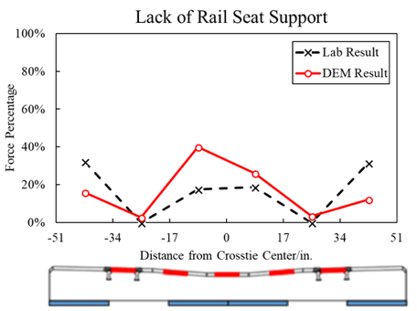
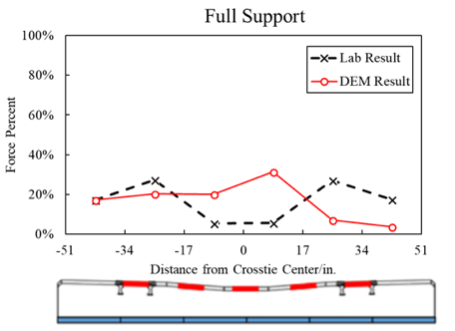
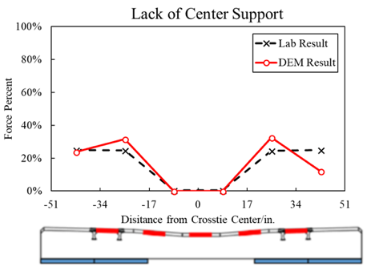
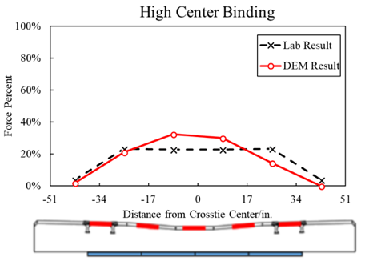
TIE-BALLAST FORCE
The trends and magnitudes of force distributions along tie bottom match reasonably.
Notes:
rubber pads, instrument sensors, bending moment.
not saying match well, talk more about full support, randomness
reasonable validation

Slide 17
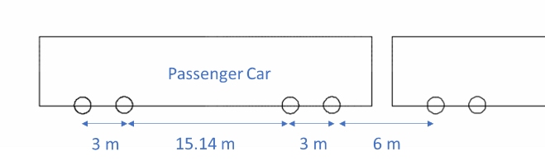
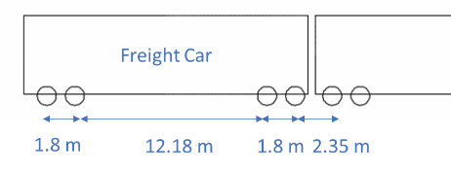
Field Loading Patterns

Slide 18
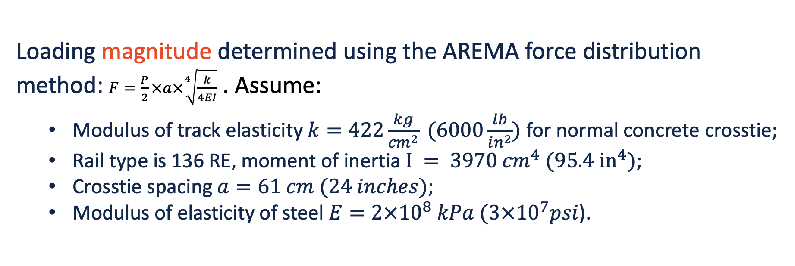
SHARED CORRIDOR LOADING PATTERNS
Loading frequency determined by the speed of trains:
freight car (1272-kN/286-kip gross rail load): 20mph, 50mph.
passenger car (636-kN/143-kip gross rail load): 110mph, 150mph.
Loading magnitude determined using the AREMA force distribution method: $F=\frac{P}{2}×a×\sqrt[4]{\frac{k}{4EI}}$ . Assume:
Modulus of track elasticity $k=422\frac{kg}{{cm}^{2}} (6000\frac{lb}{in^{2}})$ for normal concrete crosstie;
Rail type is 136 RE, moment of inertia${ I = 3970 {cm}^{4} (95.4 in}^{4})$;
Crosstie spacing$a=61 cm (24 inches)$;
Modulus of elasticity of steel $E=2×{10}^{8} kPa (3×{10}^{7}psi$).

Slide 19
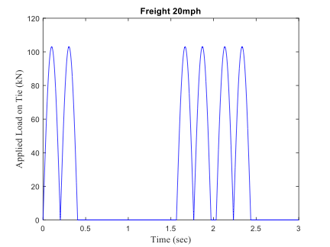
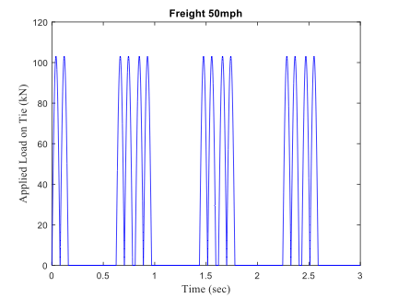
SHARED CORRIDOR LOADING PATTERNS
- Freight Car
Freight 20mph
Freight 50mph
Freight Car
Rail Seat Load = 23 kips
Notes:
text bigger

Slide 20
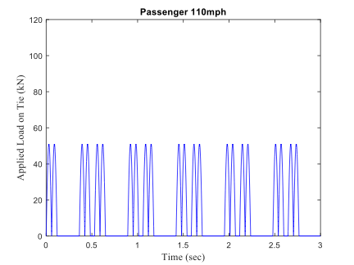
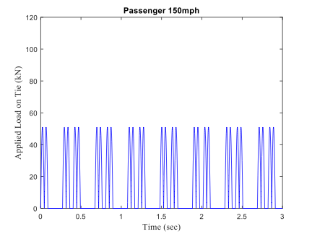
SHARE CORRIDOR LOADING PATTERNS
- Passenger Car
Passenger 110mph
Passenger 150mph
Passenger Car
Rail Seat Load = 11.5 kips

Slide 21
Results and Discussion

Slide 22
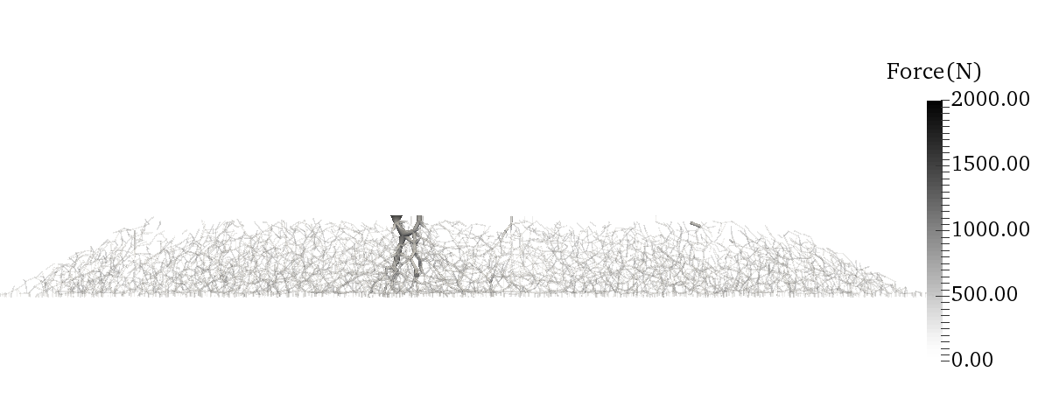

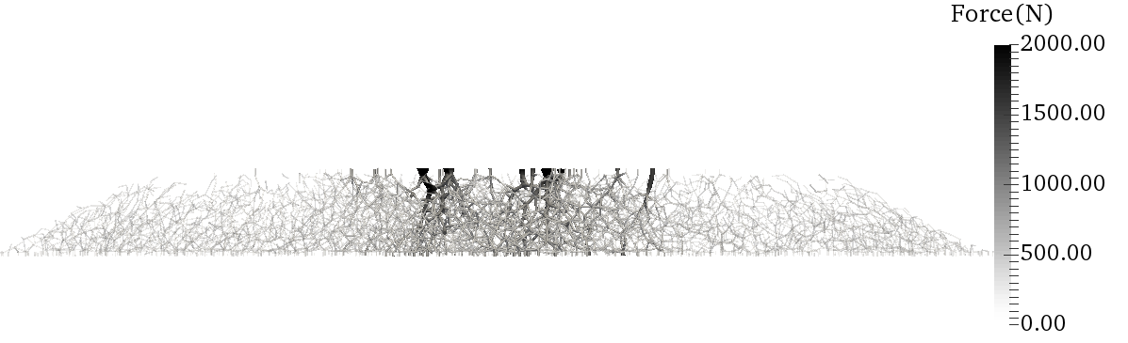
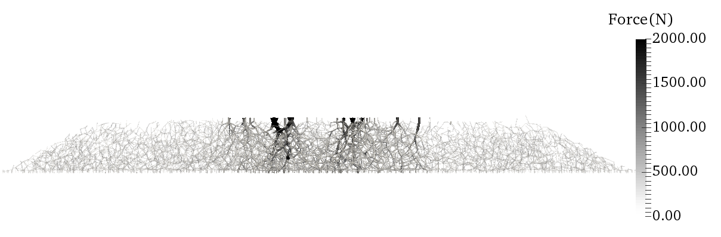
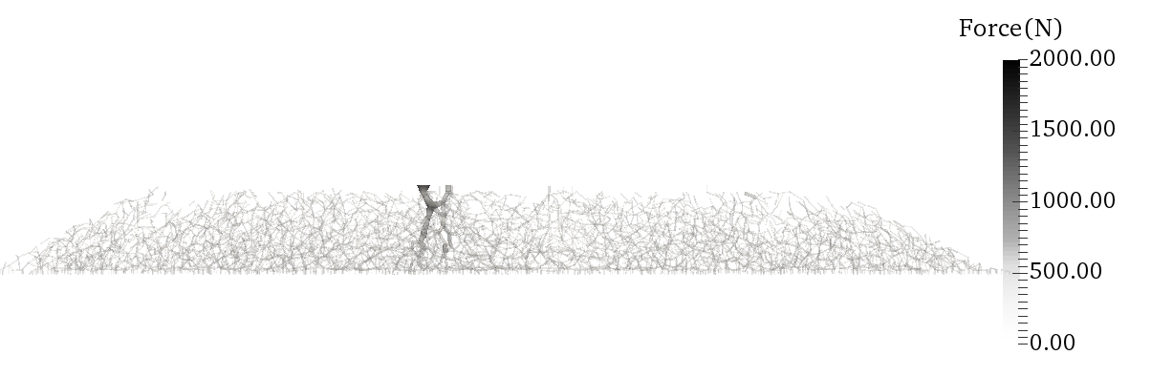
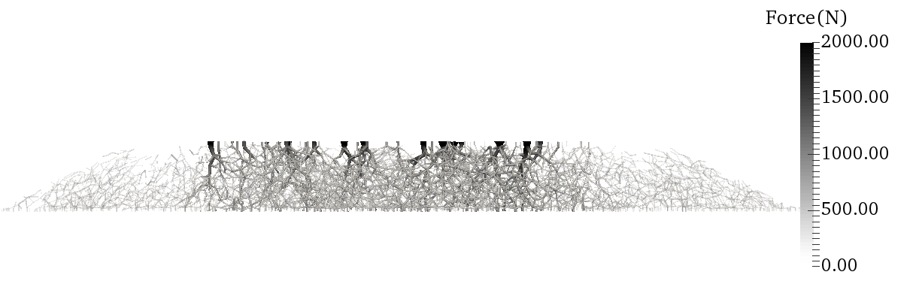
CONTACT FORCE NETWORK DEVELOPMENT
Full Support
‘Critical Path(s)’ experience higher contact force and longer loading duration.
Notes:
one support on one slide

Slide 23
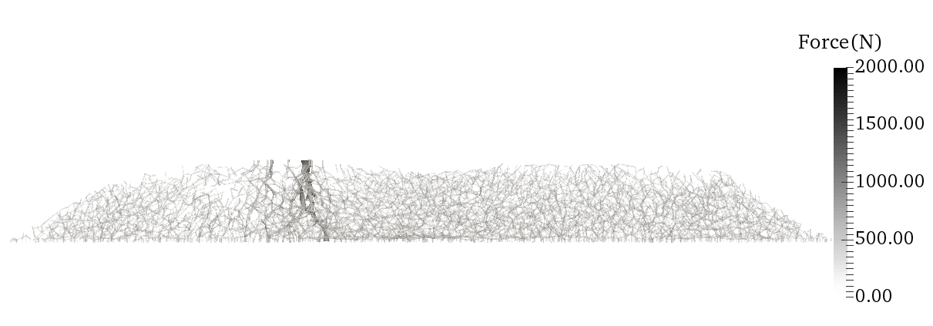
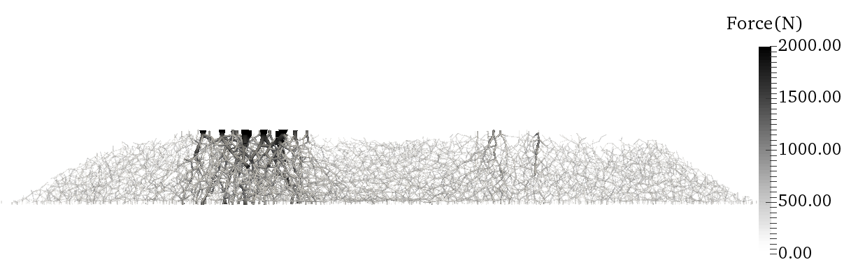
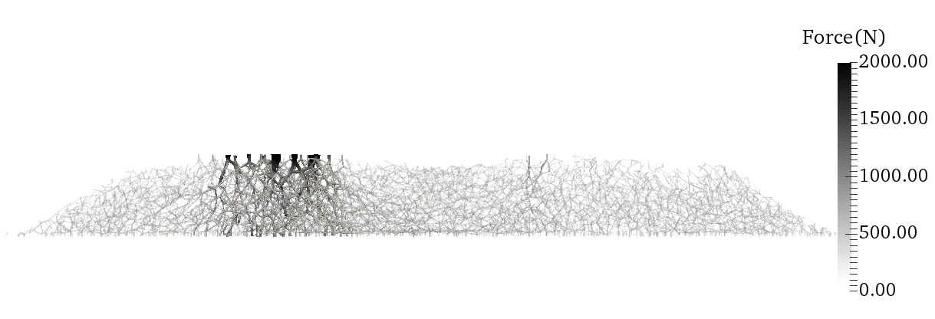
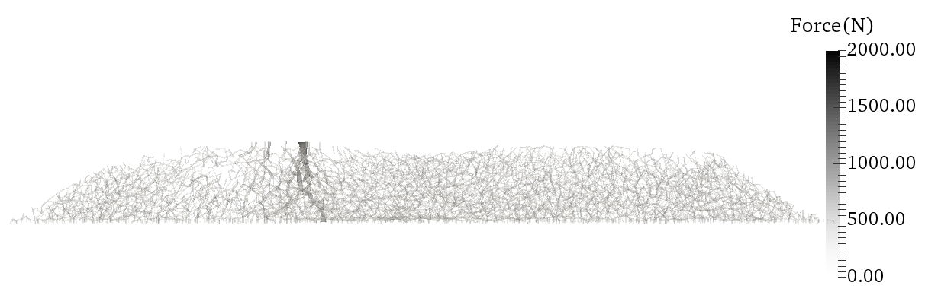
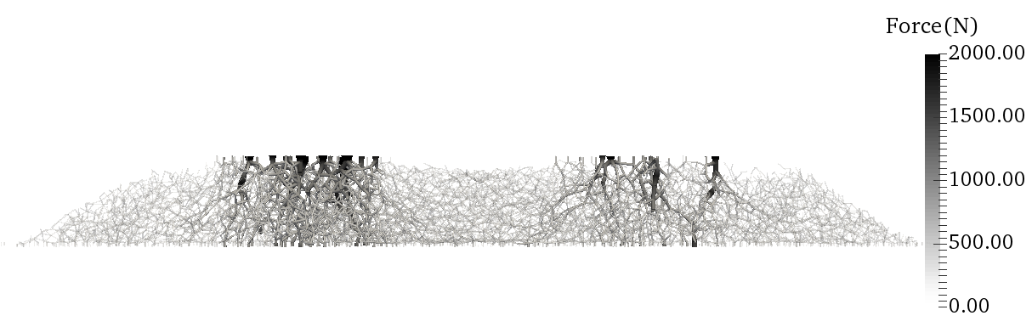
CONTACT FORCE NETWORK DEVELOPMENT
Lack of Center Support
‘Critical Path(s)’ experience higher contact force and longer loading duration.

Slide 24
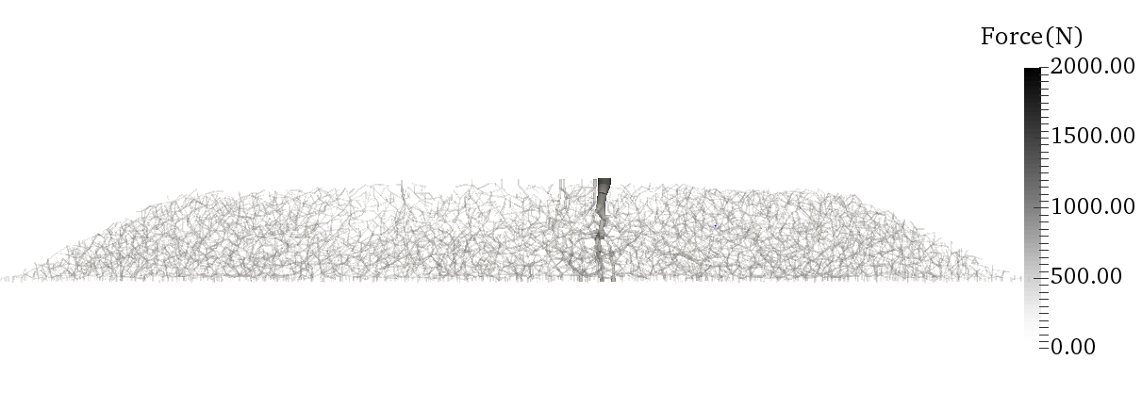
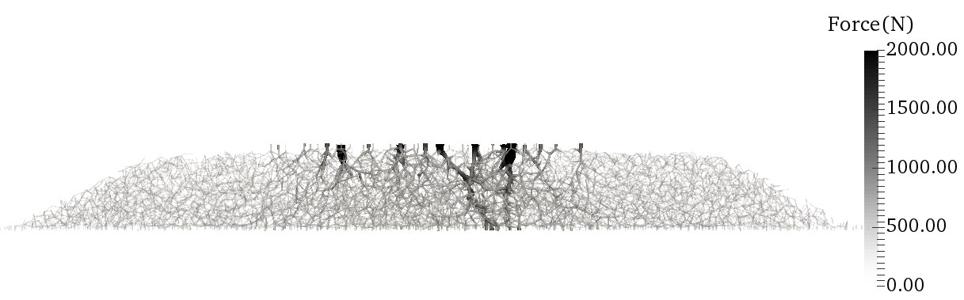
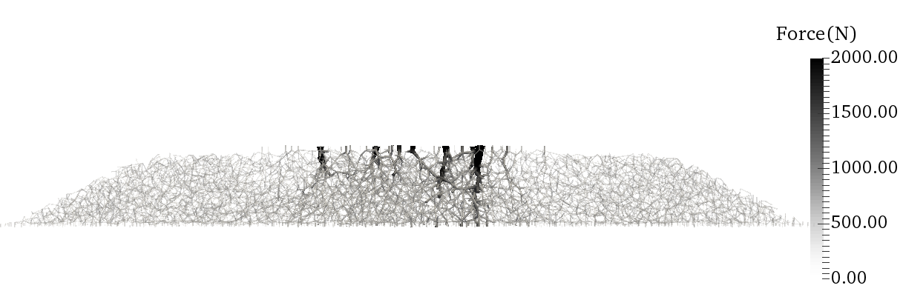
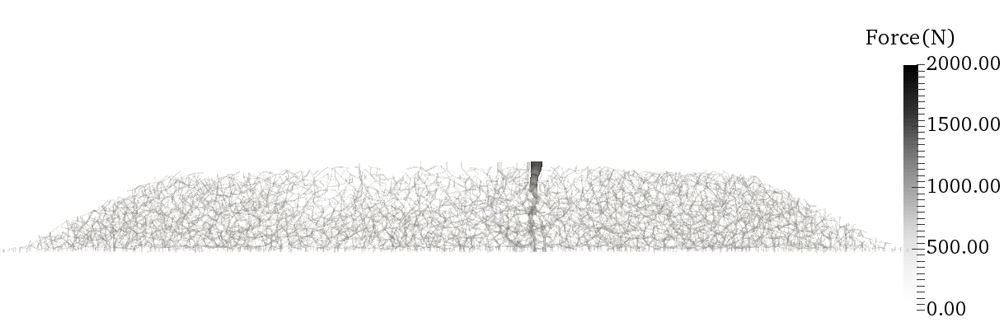
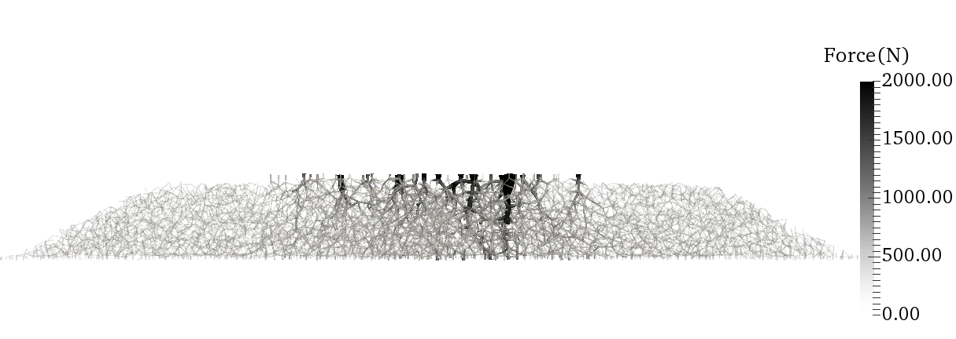
CONTACT FORCE NETWORK DEVELOPMENT
High Center Binding
‘Critical Path(s)’ experience higher contact force and longer loading duration.

Slide 25
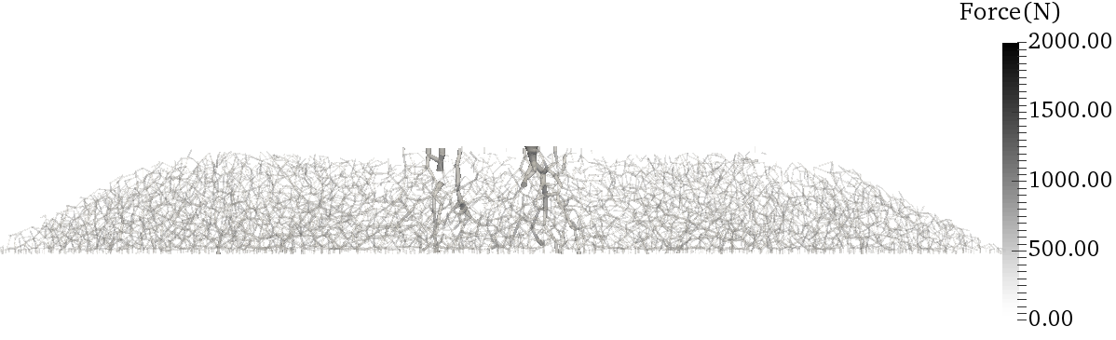
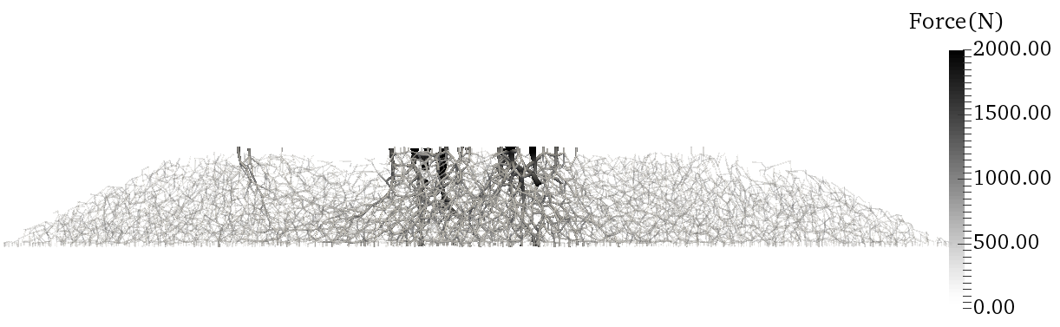
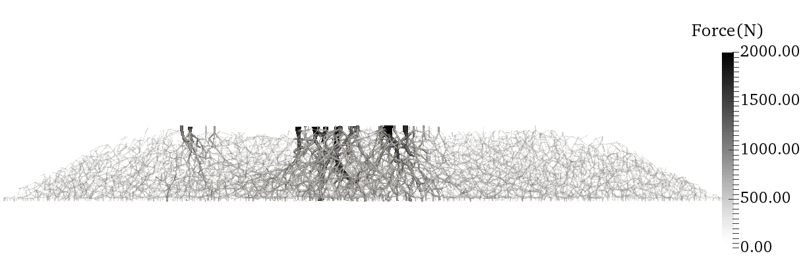
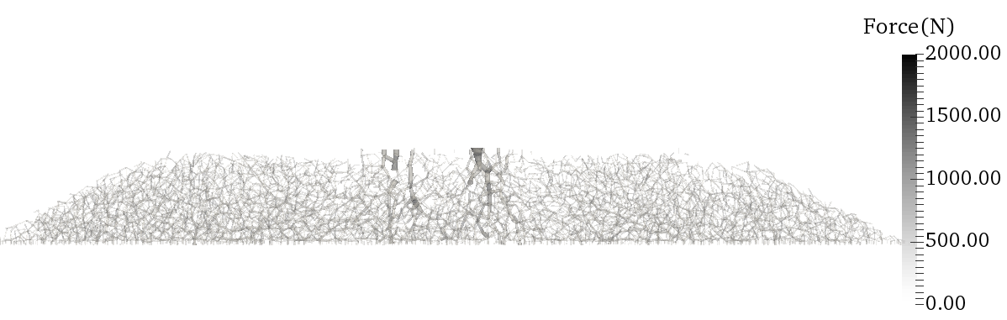
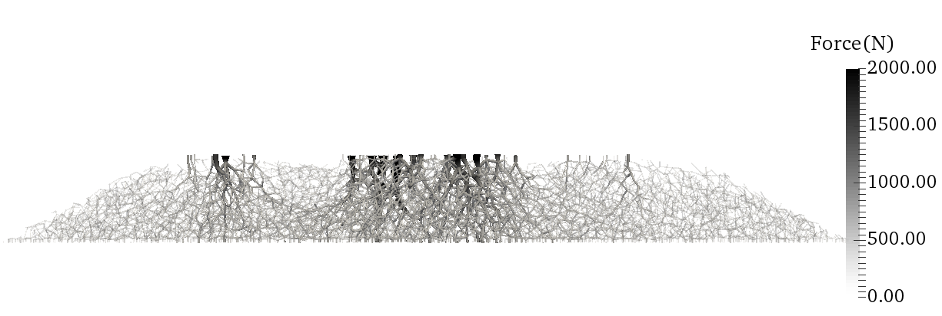
CONTACT FORCE NETWORK DEVELOPMENT
Lack of Rail Seat Support
‘Critical Path(s)’ experience higher contact force and longer loading duration.

Slide 26
CROSSTIE VIBRATION VELOCITY
 | 20 mph–freight car | 50 mph – freight car | 110 mph – passenger car | 150 mph – passenger car
Full Support
Lack of Center Support
High Center Binding
Lack of Rail Seat Support

Slide 27
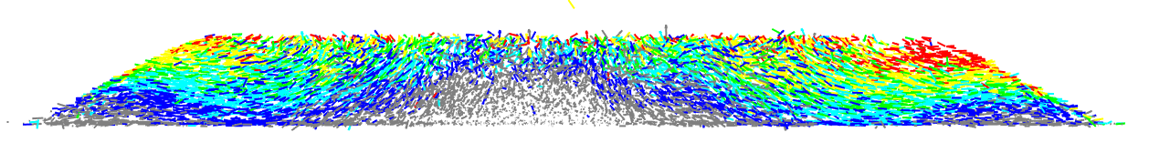




BALLAST PARTICLE MOVEMENT
Full Support
0 5 10 15 20 30
Ballast movement (mm)
Lack of Center Support
20 mph
freight car
0 5 10 15 20 30
Ballast movement (mm)
High Center Binding
0 5 10 15 20 30
Ballast movement (mm)
Lack of Rail Seat Support
0 5 10 15 20 30
Ballast movement (mm)
Notes:
tie break in the middle (worst thing for tie design), but not for ballast movement

Slide 28




BALLAST PARTICLE MOVEMENT
Full Support
0 5 10 15 20 30
Ballast Movement (mm)
Lack of Center Support
50 mph
freight car
0 5 10 15 20 30
Ballast Movement (mm)
High Center Binding
0 5 10 15 20 30
Ballast Movement (mm)
Lack of Rail Seat Support
0 5 10 15 20 30
Ballast Movement (mm)

Slide 29




BALLAST PARTICLE MOVEMENT
Full Support
0 5 10 15 20 30
Ballast Movement (mm)
Lack of Center Support
110 mph
passenger car
0 5 10 15 20 30
Ballast Movement (mm)
High Center Binding
0 5 10 15 20 30
Ballast Movement (mm)
Lack of Rail Seat Support
0 5 10 15 20 30
Ballast Movement (mm)

Slide 30




BALLAST PARTICLE MOVEMENT
Full Support
0 5 10 15 20 30
Ballast Movement (mm)
Lack of Center Support
0 5 10 15 20 30
150 mph
passenger car
Ballast Movement (mm)
High Center Binding
0 5 10 15 20 30
Ballast Movement (mm)
Lack of Rail Seat Support
0 5 10 15 20 30
Ballast Movement (mm)

Slide 31
Conclusions & Future Research

Slide 32
CURRENT FINDINGS
One or two connected ballast force networks as critical path(s) were always observed in all support conditions during a loading cycle
Ballast particles on the critical path experienced higher contact force and longer loading duration, which can eventually lead to earlier particle breakage and faster ballast degradation
Freight car loads at 50 mph induced the highest magnitude of crosstie vibration velocities in three support conditions other than the full support condition.
Notes:
pop text one by one

Slide 33
CURRENT FINDINGS
Ballast particles had the largest movements under freight car loads at 20 mph. Higher load magnitudes had a more significant influence than speed increasing
Large ballast particle movements indicate less stability for the ballast layer and may lead to more severe loss of support conditions
High center binding support experienced the smallest ballast particle movements
Other three support conditions all showed significant ballast particle movements towards the shoulders and in the upper half of the ballast layer

Slide 34
Recommendations for Future Research
Various mixed traffic conditions, e.g. freight train passage followed by faster passenger train, will be studied next
Ballast behavior under mixed traffic at track transitions
Effects of tie-ballast gaps
Remedial procedures for ballast correction, i.e. tamping and stone blowing, will be studied

Slide 35





ACKNOWLEDGEMENTS
Amtrak Concrete Tie and Track Structure
Improvement Study
J. Riley Edwards, Marcus Dersch and RailTEC at UIUC
Huseyin Boler & Wei Li, graduate students
Dr. Yu Qian, Assistant Professor, University of South Carolina

Slide 36
Thank you!
Questions?

